Slide 1
Community-Engaged STEM Certificate Program

Slide 2
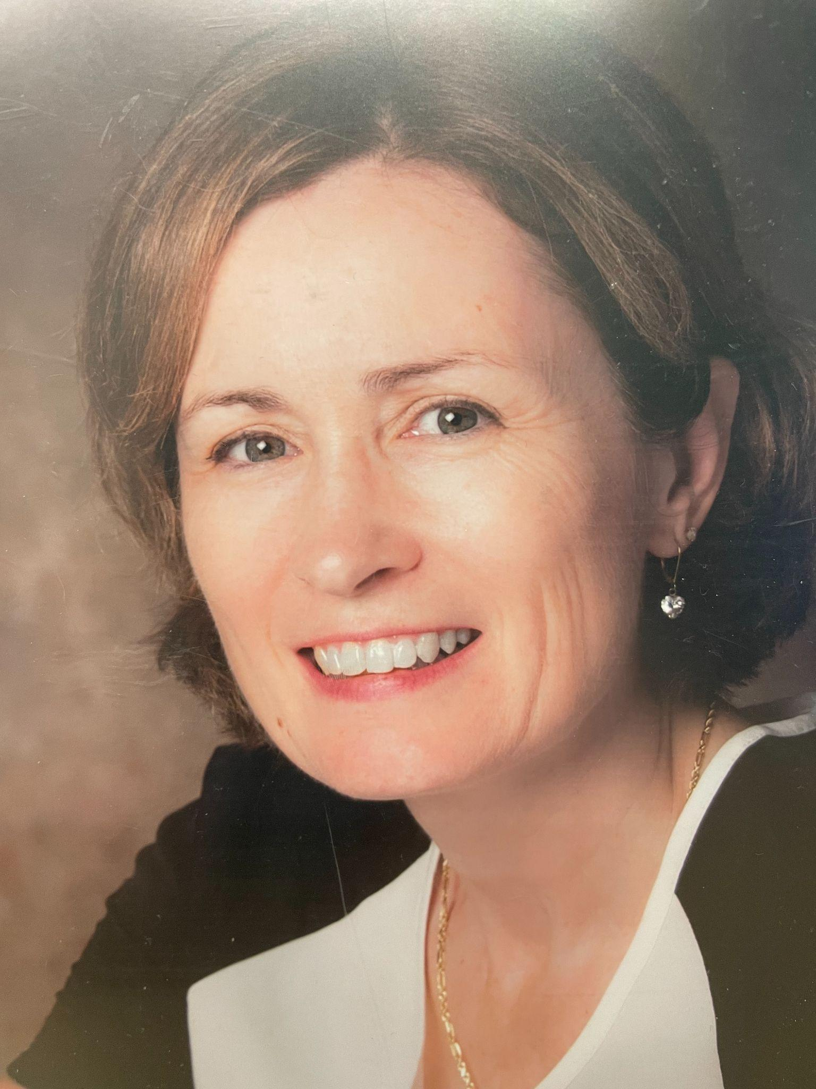
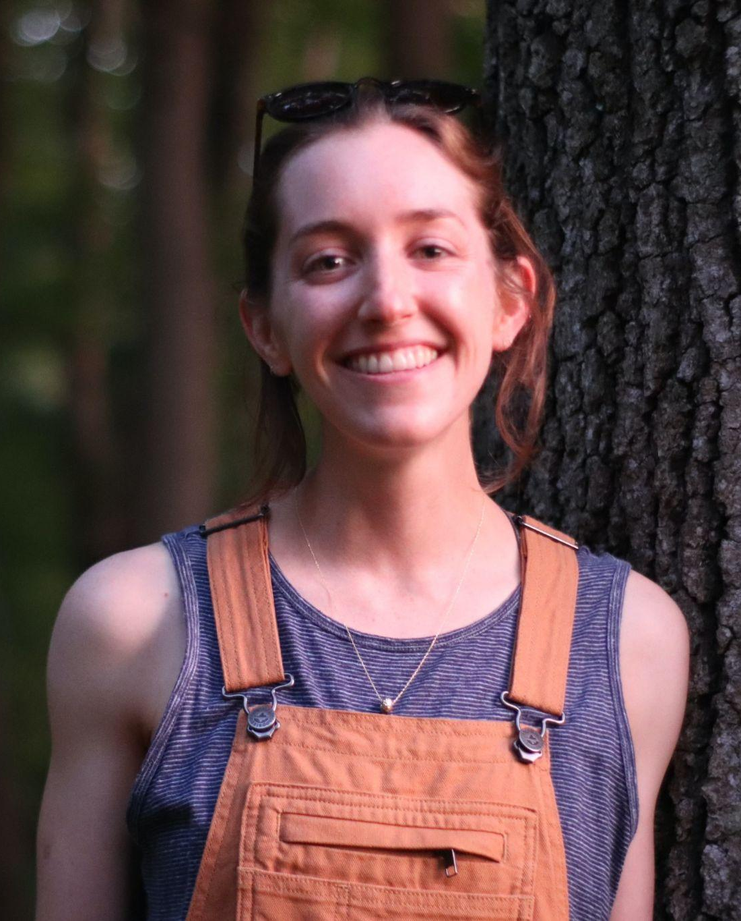
Lori Flanagan-Cato, PhD
Certificate Director
Erin Purvis, PhD (NGG Graduate)
Certificate Development

Slide 3
About the Program
Why?
The scientific community has an urgent responsibility to provide better access and understanding of basic STEM knowledge and new discoveries to a broader spectrum of our society.
How?
This educational program will invest in BGS students the skills needed to collaborate with community partners, especially underserved groups, to improve science and biomedical literacy.
Who?
A team of community-engaged faculty advisors, including BGS faculty, PSOM clinicians, and SAS basic scientists.

Slide 4
Certificate Requirements
Anticipated that students will take ~2 years to complete the certificate (flexible)
Courses
Community Engagement
Monthly Seminar
Capstone

Slide 5
Coursework
The Penn Experience (virtual)
Research & Community: Biomedical Science in the Urban Curriculum
Spring semester
One elective course
More than a dozen options

Slide 6
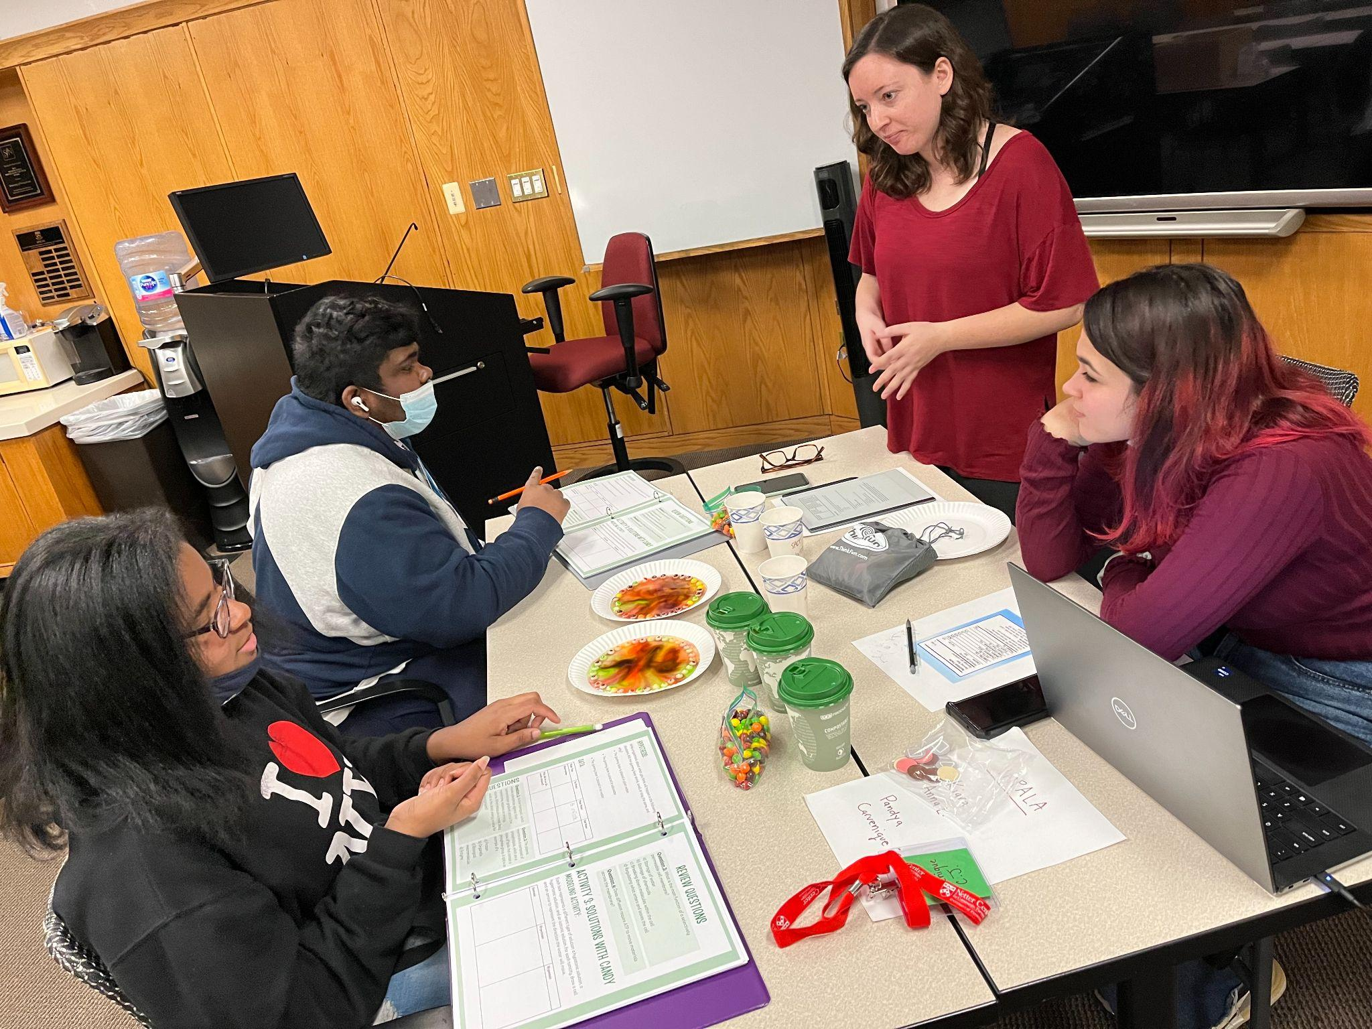
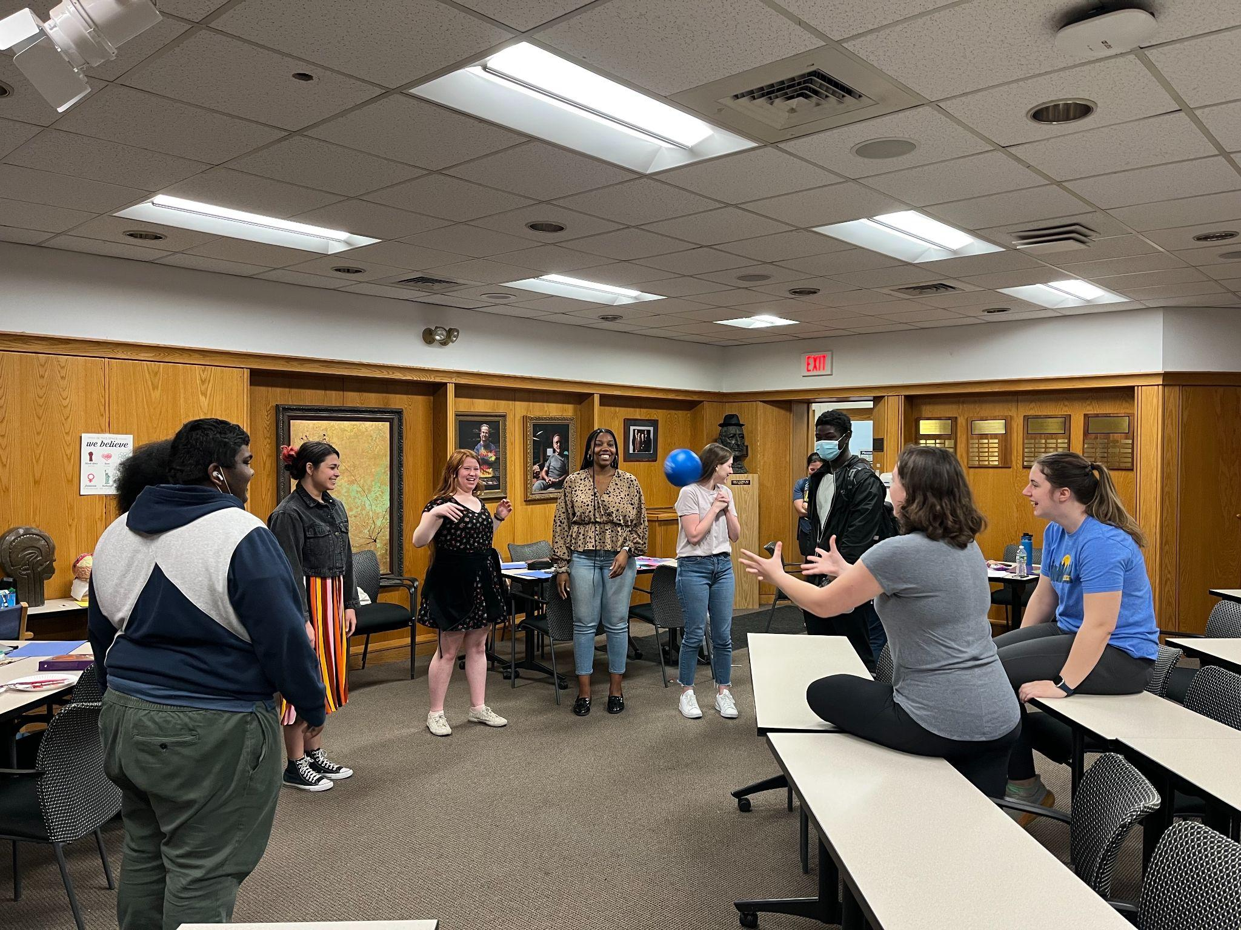
Research & Community: Biomedical Science in the Urban Curriculum
Learning about diffusion
Learning a memory task

Slide 7
Student Reflection
“Through this experience, I was able to see the clear gap in resources between students at a private university such as Penn and high school students in the public system. This has made it clear to me that institutions such as Penn have a moral obligation to use every resource at their disposal, including students, to have a positive impact on the community… Thinking about my research in terms of how it can affect the community around me has also helped me think more deeply about the people I want to help, instead of keeping it all on a lab bench for five or more years.”

Slide 8
Student Reflection
“After taking this class, I realized that incorporating community engagement into my research on ACL reconstruction could lead to better patient outcomes. With community needs and concerns in mind, researchers can develop more effective interventions and better support patients during their recovery. We need more people trained to solve real-world problems, and this class has helped me to better understand how I can make a positive impact.”

Slide 9
Engagement
At least 40 hours of focused, STEM-related, mentored community engagement
Example engagement opportunities:
Project BioEYES
DrosoPHILA
Community School Student Partnerships
Educational Pipeline Program
Students for Environmental Equity

Slide 10
Research Seminar
Participation for 1 year in a monthly research seminar featuring rotating faculty presenters discussing their involvement with community-engaged work at Penn
Upcoming Seminars:
Monday, September 23rd at 12 pm (BRB 253)
Monday, October 7th at 12 pm
Attend the September seminar to enroll in the program!

Slide 11
Capstone Project
A scholarly product of your community-engaged work.
Possible formats:
Research paper
Conference presentation
Development of resources for the community
Contribution to a community engagement workshop

Slide 12
Possible timeline
Semester 1:
Penn Experience
Seminar
Semester 2:
Req’d course
Seminar
Semester 3:
Elective
Community Engagement
Semester 4:
Capstone

Slide 13
Questions?
epurvis@pennmedicine.upenn.edu
To enroll: https://www.med.upenn.edu/cescp/application
September 23rd at 12 pm in BRB 253

Slide 14
https://www.med.upenn.edu/cescp

