Slide 1
^{#BGSOrientation #PENNBGS4U}
Today’s program:
Certificate Programs – (Various), 1 hr
Career Development — Steve, ~ 40 min
  Theme: Capitalize on your Skills & Traits.
BioTech Commons Open House

Slide 2
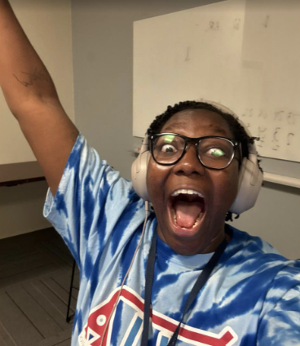
Back to Kyndall Nicholas’ talk …
Grow your community.
Curate a playlist for YOURSELF!

Slide 3


Your Community …
Engage in Philadelphia and
the Commonwealth of PA
Register to VOTE in PA!
+

Slide 4
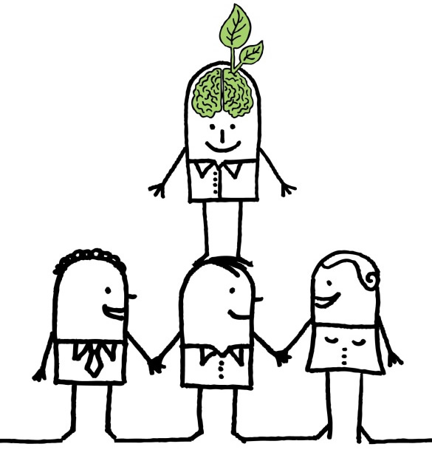
The beauty: it’s a cycle!
By executing ‘GOOD’ science …
And creating your ‘professional’ self …
You become the shoulders to stand on!
You are here
Carry out research done:
Responsibly
Reproducibly
& with Rigor!
Today: To what purpose will you put that PhD?
Notes:
Requires that the science that came before is done Responsibly
Reproducibly
& with Rigor.

Slide 5
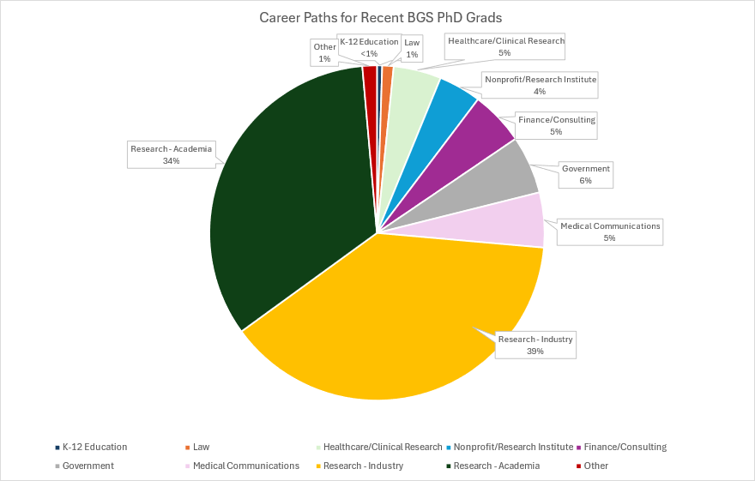
Compiled 2024;
Data to 2018

Slide 6
How to tackle career development?
I. Cultivating research-specific skills and traits.
II. Using an Individual Development Plan (IDP).
III. How to explore career options.

Slide 7

How to tackle career development?
This year → Symposium for the 40th Anniversary of BGS!
Alums will be here to discuss their paths and choices.
https://www.med.upenn.edu/bgs-at-40/

Slide 8
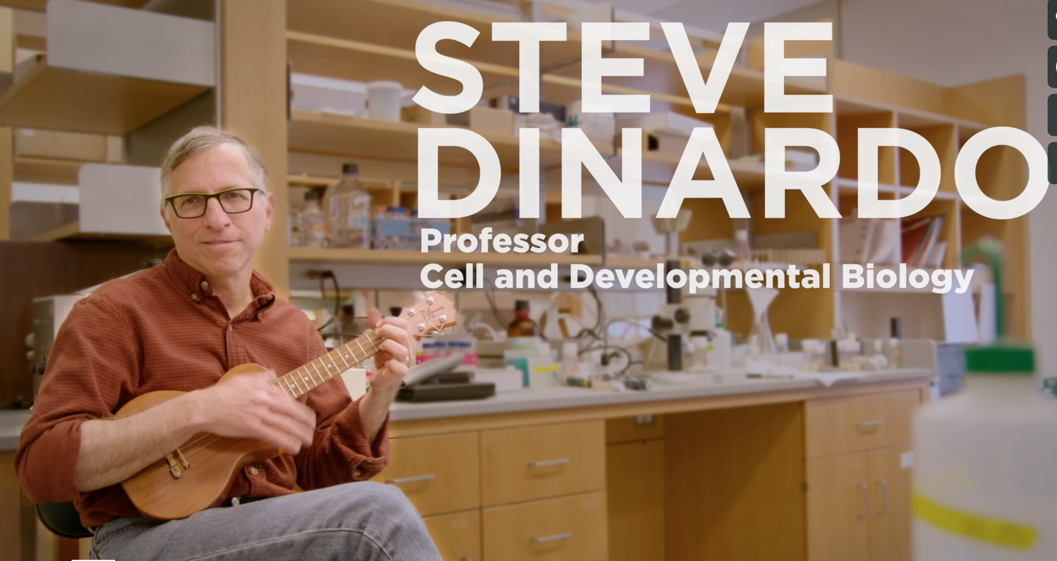
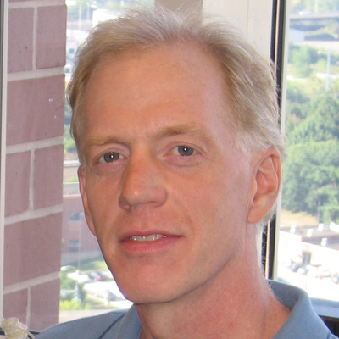
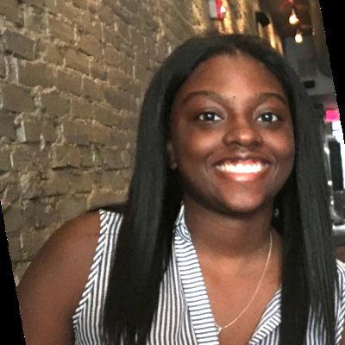
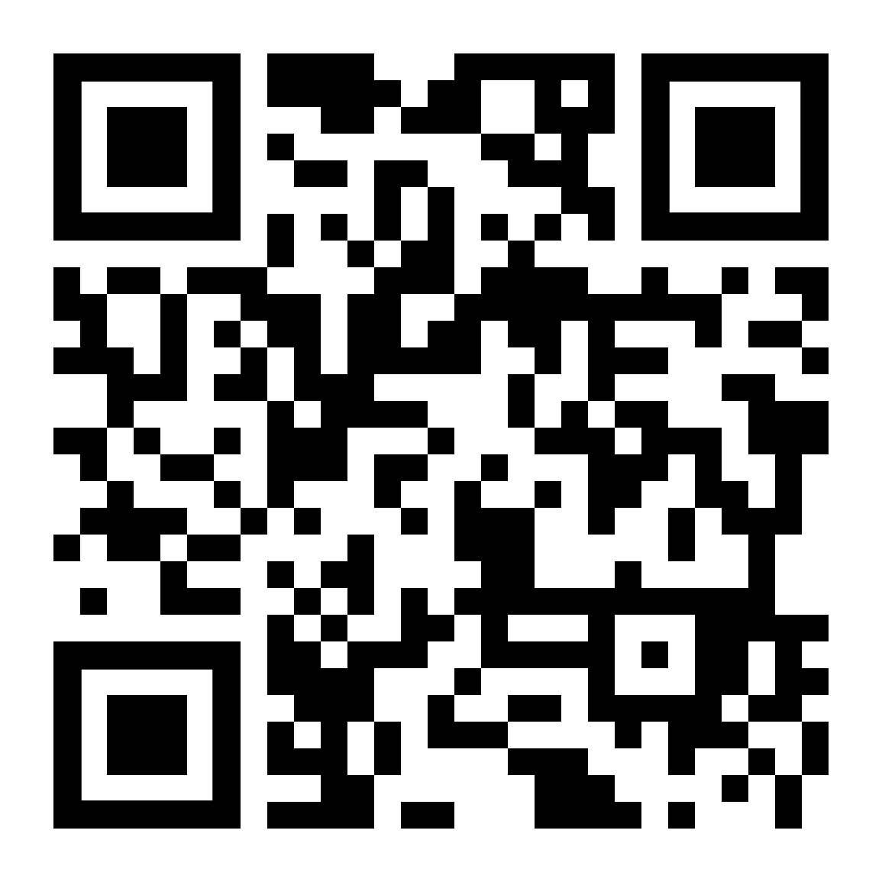
Career Development
Kurt Engleka
Assistant Director of
Curriculum;
(he, him)
Candace Cain
Career Development Coordinator;
(she, her)
Director, Training Support &
Career Development;
(he, him)
Biomedical Graduate Studies
BGS Career Development Website
Notes:
The idea in today’s talk and panel session is to provide you with a more clear idea of what PhD training is about and how this positions you for employment within different kinds of careers.

Slide 9
what Qualities are instilled by your PhD Training ?
PhD Training
Skills
Traits
… that are an absolute requirement for any
research-intensive scientific endeavor

Slide 10
Skills from your phD
pause,

Slide 11
Skills from your phD
Critical Thinking
Acquiring and processing of information
Gauging evidence and arguments
Recognizing assumptions
Recognizing logical relationships
Drawing warranted conclusions
Competence in Mathematical and
Computational Practices
Mathematical reasoning
Statistical inference
Systems-level modeling
Proficiency in Experimental Design
Articulating a scientific premise
Developing a hypothesis
Testing hypotheses/Protocol design
Reagent validation/Troubleshooting
Data management
Management
Time management
Project management
Work ethic; work/life balance
Mentorship
Leading and motivating others
Networking
Conflict management
Communication
Clarity, precision, and intent
Effective listening and feedback
Manuscript writing
Grant writing
Posters/multimedia
Speaking to a scientific audience
Speaking to a lay audience

Slide 12
traits from your phD
Self-motivation & High-level work ethic
Focus
Persistence -- Resilience
Curiosity: a desire for answers,
  and a love of the search
Capacity to balance Receptivity with Skepticism
Creativity -- Imagination
Adapted from Emotional Competency

Slide 13
Concerning career success:
Qualities that PhD Training instills in you
PhD Training
Skills
Traits
– absolute requirements in any form of research-intensive scientific endeavor
– highly sought in a variety of other enterprises.

Slide 14

With The right mix
You can choose your path!
•Skills
•Traits
•Your Interests
•Your Values

Slide 15
How to tackle career development?
CREATE YOUR ‘PROFESSIONAL SELF’
You will be here*
I. Do good science!
Focus on cultivating the essential skills and traits

Slide 16
How to tackle career development?
I. Focus on developing and cultivating
research-specific skills and traits.
II. Mentorship compact
& Individual development plan (IDP).
III. How to explore?
Notes:
With regard to the specific elements of …. I have just mentioned the first and most important, which is to focus on developing and/or….

Slide 17
Mentorship Compact
Description…..
      A written document used to articulate expectations between mentors and mentees
      Focused on daily/weekly expectations for the working relationship
      Review together at the beginning and periodically throughout
      Differs from the Individual Development Plan (IDP) which focuses on short and long-term career plans
      The value…..
      Documentation of expectations which can be revisited and revised
      A shared reference point for regular progress reviews
      Makes invisible expectations, visible
      Levels the playing field among mentees

Slide 18

Individualized Development Plan
UP FRONT ASSESSMENT:
  WHAT IS NEEDED TO ACHIEVE YOUR GOAL?
  WHAT ARE YOUR SPECIFIC NEEDS AS A MENTEE?
    SCIENTIFIC SKILLS
    PROFESSIONAL SKILLS
    CAREER SKILLS
    OTHER SUPPORT
ESTABLISH MUTUATL AND BENEFICIAL EXPECTATIONS
COMMUNICATE THE EXPECTATIONS
ALIGN EXPECTATIONS BETWEEN MENTOR AND MENTEE
REVISIT EXPECTATIONS AND ADJUST WITH MENTEE GROWTH

Slide 19
Individual Development Plan
A Collaborative
Mentor-Mentee Venture
Goals of your IDP:
  Pause & thoughtfully evaluate research progress
  Assess your career objectives
    Both short- & longer-term
  Collaboratively design a plan to achieve your objectives
IDPs are required yearly.
  This is a ‘living document’ that changes with your progress and as your aspirations change

Slide 20
Individual Development Plan
A Collaborative
Mentor-Mentee Venture
Extra benefit of your IDP meeting:
  A programmed-in Mentor-Mentee discussion
  Reflect on last week’s Mentoring Workshop:
    Communication (Active Listening)
    Expectations (Alignment)
    Collaborative Strategies (Set & Meet goals)
Incredible opportunity

Slide 21
How to tackle career development?
I. Focus on developing and cultivating
research-specific skills and traits.
II. Individual development plans (IDPs).
III. How to explore?
What can I explore?

Slide 22
The evidence is you can and should explore what you want.

Slide 23
How to tackle career development?
I. Focus on developing and/or cultivating research-specific skills and traits.
II. Individual development plans (IDPs).
III. How can I explore?
BGS certificate programs (today)
* Student groups (you’ve met ‘em!!)

Slide 24
The Symposium!
This year → Symposium for the 40th Anniversary of BGS!
Alums will be here to discuss their paths and choices.
https://www.med.upenn.edu/bgs-at-40/

Slide 25
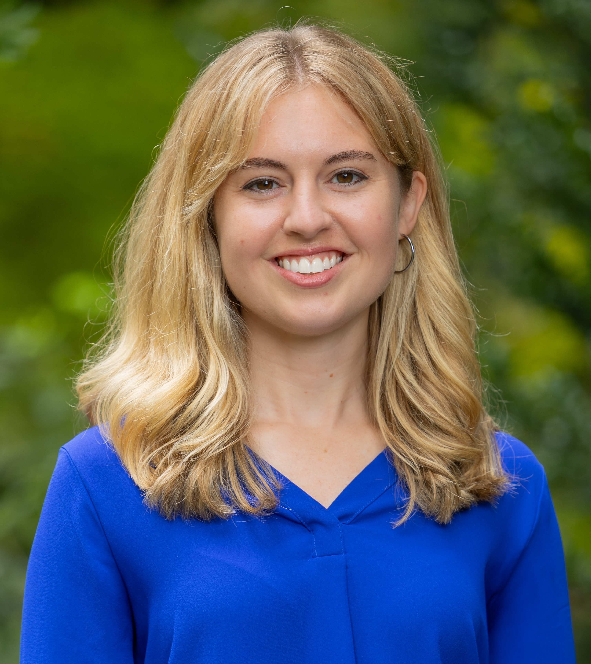
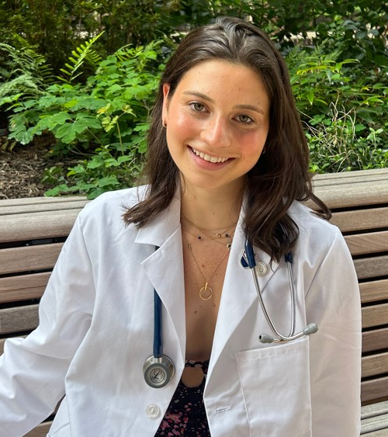
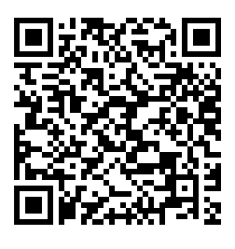
Career Paths Mentoring Program
Designed by a BGS trainee:
Laura Ohl
Current Program Leaders:
Program Goals
Frequent and long-lasting interactions between trainees and alumni
Networking and professional development including relationship building, teamwork, and mentoring
Expose students to diverse career paths through alumni experiences
Emily: Emily.Daley1@pennmedicine.upenn.edu
Julia: Julia.Gardner@Pennmedicine.upenn.edu
CPMP general email: pennbgscpmp@gmail.com
https://www.med.upenn.edu/bgs/career-paths-mentorship-program-with-bgs-alumni.html

Slide 26
Career Paths Mentoring Program
How does it work?
Students are matched with BGS alumni in a small-group format. Matching is based on student interest survey.
Student/alumni groups meet once per month via zoom from November – May
Students come prepared with questions each month and alumni share career advice, networks, and experiences
Emily: Emily.Daley1@pennmedicine.upenn.edu
Julia: Julia.Gardner@Pennmedicine.upenn.edu
CPMP general email: pennbgscpmp@gmail.com
Sign Up:
October
https://www.med.upenn.edu/bgs/career-paths-mentorship-program-with-bgs-alumni.html

Slide 27
MyriaD other Options
Graduate group-specific workshops
Training grant-specific workshops
Center for Teaching and Learning: CTL Teaching Certificate
Penn Center for Innovation: PCI Fellows Program
  https://pci.upenn.edu/pci-fellows/
Notes:
There exist within BGS 3 certificate programs that provide an extra dimension to what’s required of you through your graduate group
… to explore such items and science policy, patent law, business
…

Slide 28
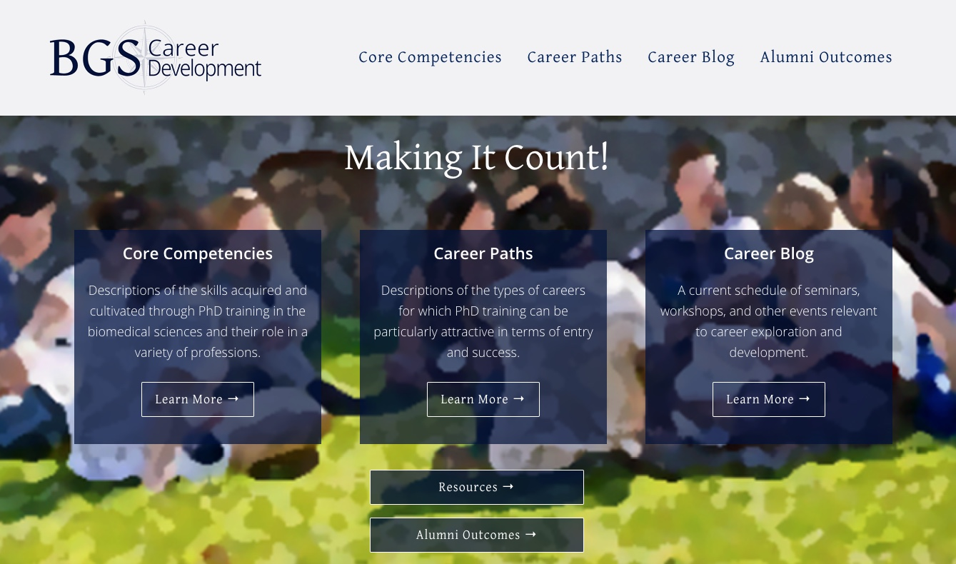
BGS Career development
Website
(DiNardo, Jackson, Engleka & Cain)

Slide 29
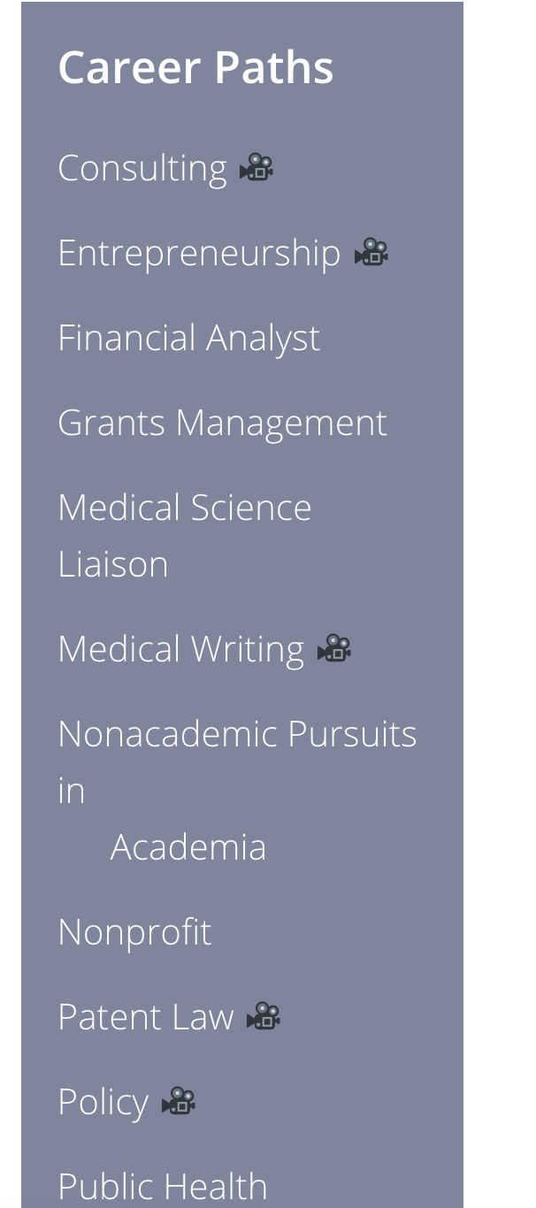
Career development website
Notes:
…..if there’s any kind of career event going on in BGS or something relevant in the university you’re going to find it here. You should really try to access this every week.

Slide 30
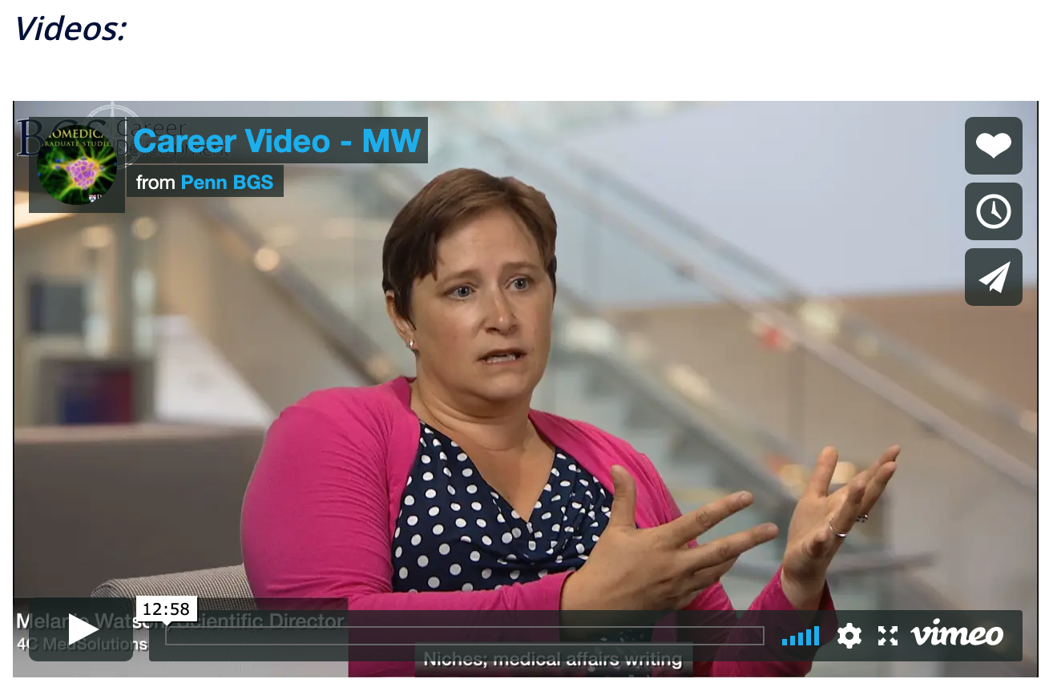
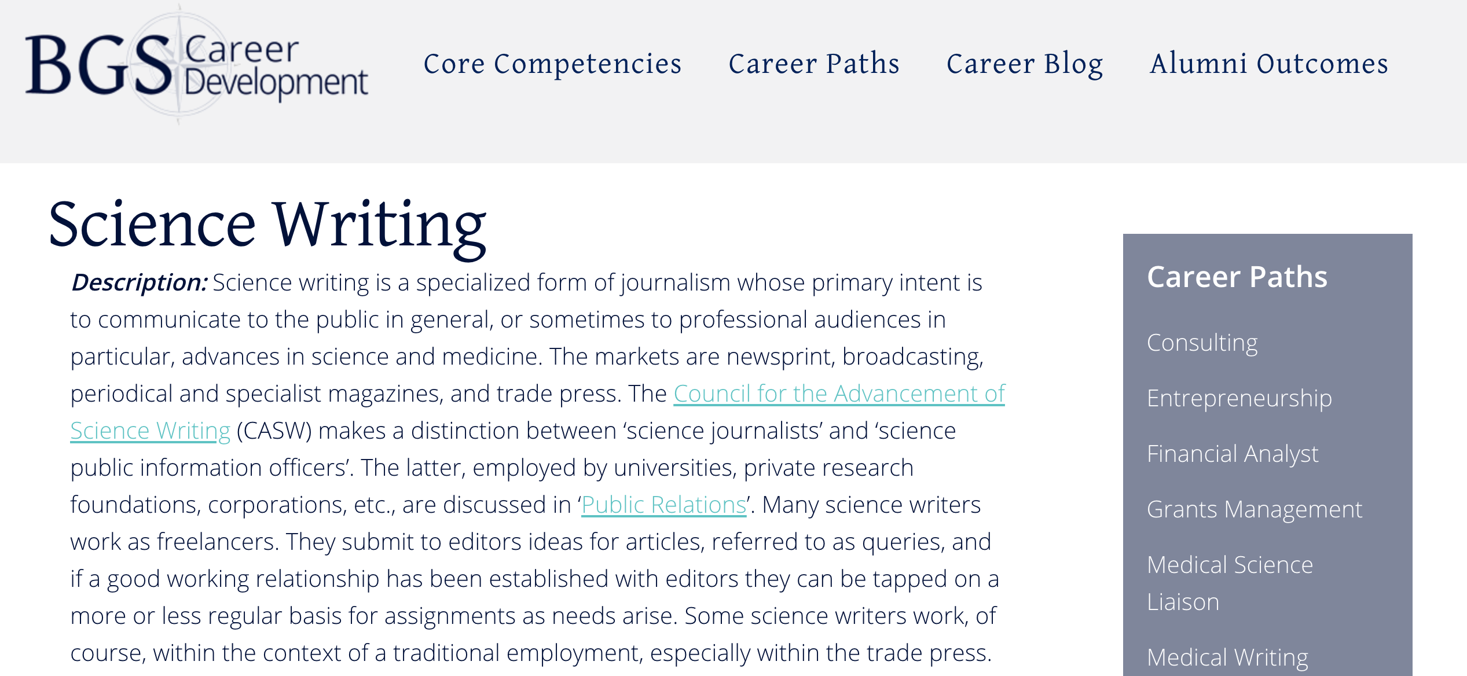
Career development website
Informative video shorts
by Alums
Notes:
…..if there’s any kind of career event going on in BGS or something relevant in the university you’re going to find it here. You should really try to access this every week.

Slide 31
The Bottom line:
Leverage your PhD training to make the greatest possible impact on society.
Whatever path YOU choose, you will have the Skills and Traits to succeed.

Slide 32
Your Community …
Engage in Philadelphia and
the Commonwealth of PA
Register to VOTE in PA!
+

