Slide 1





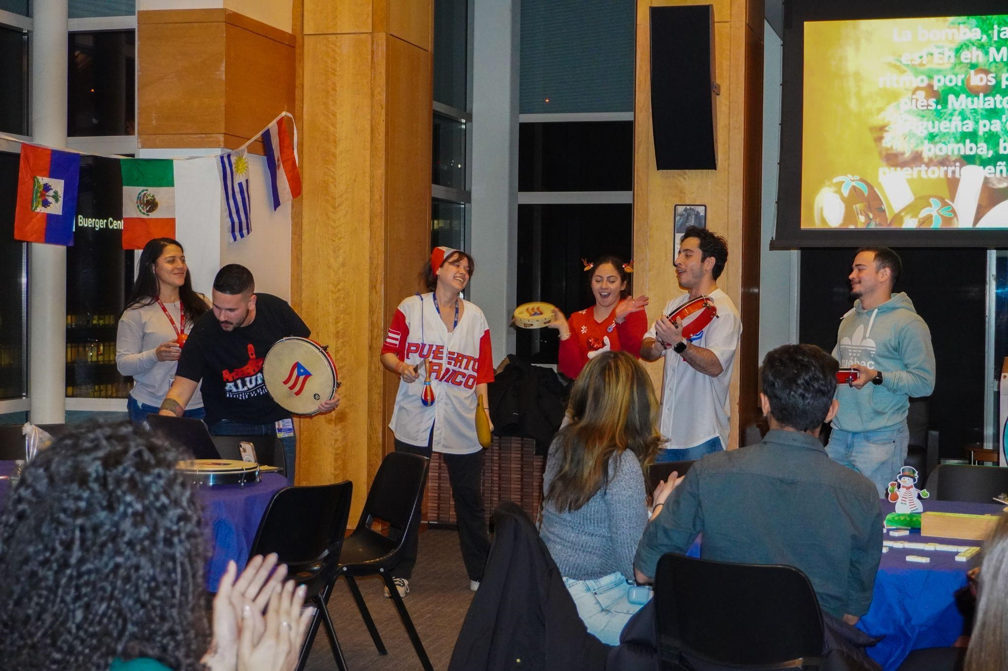
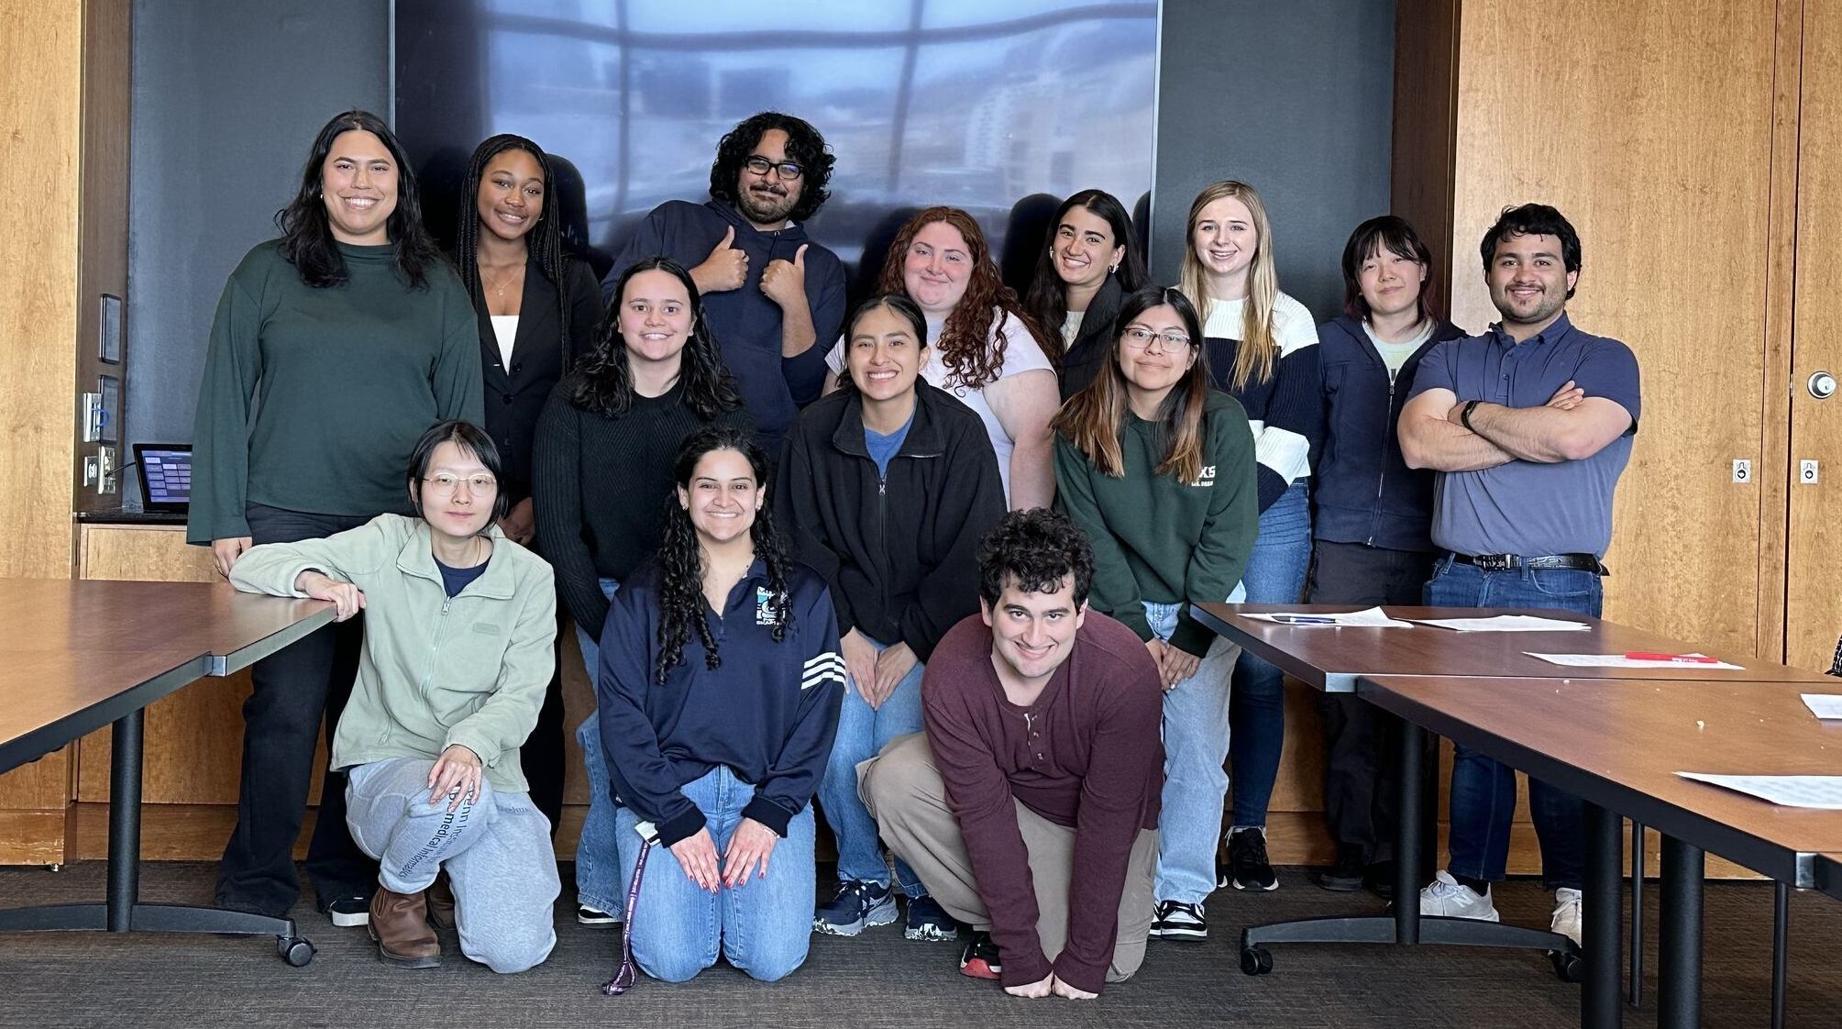
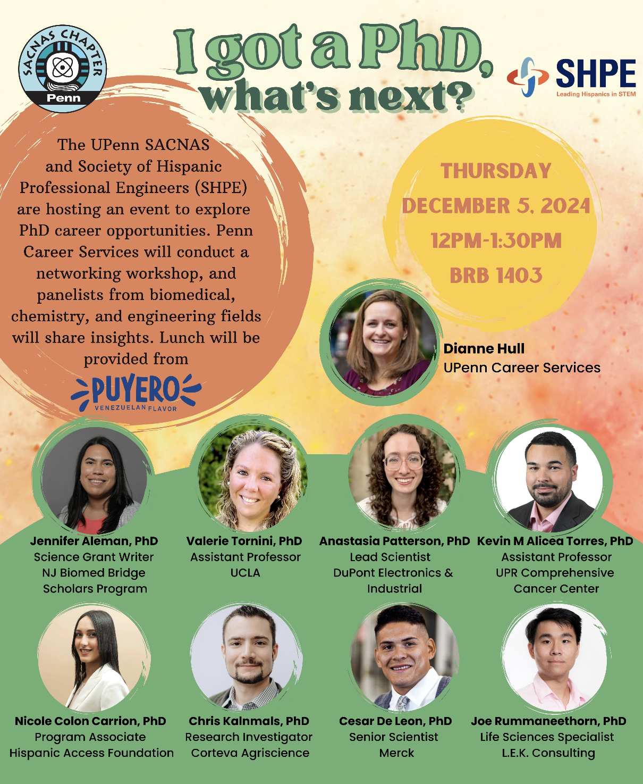
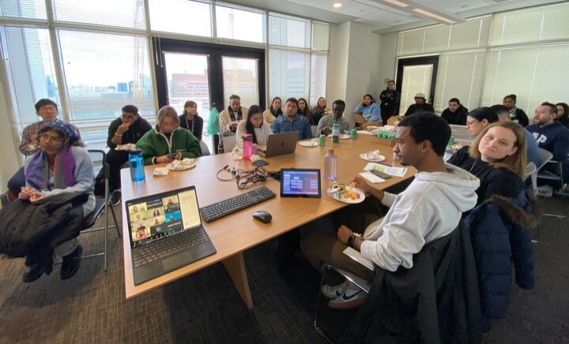



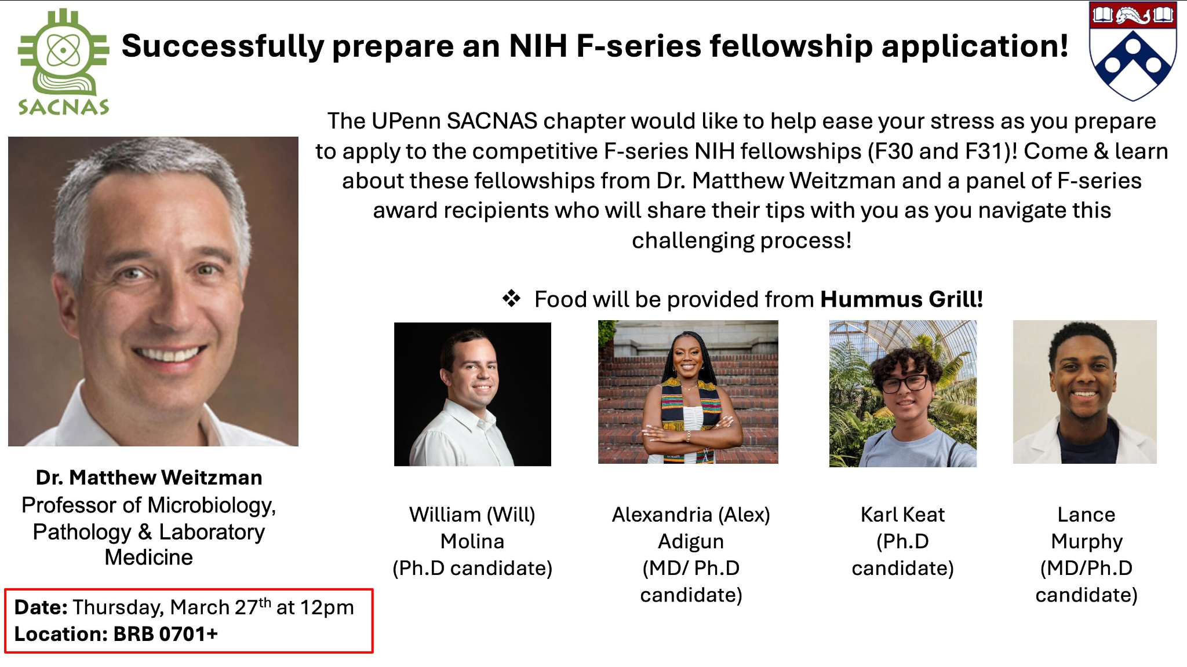
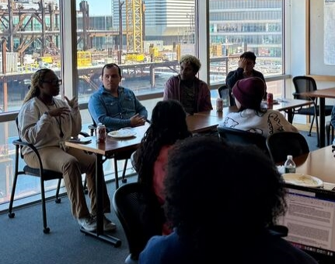
Society for the Advancement of Chicanos/Hispanics and Native Americans in Science
SACNAS is an inclusive organization dedicated to fostering the success of underrepresented leaders in STEM without losing their connection to their communities and culture.
Penn Chapter Mission: “Provide support, as well as academic and professional development opportunities for graduate students in science”
Join our newsletter!
Community Building & Social Events
Science Outreach
Academic & Professional Development
Penn x The College of New Jersey (TCNJ) SACNAS Visit
Notes:
Joa

